Slide 1
Overview of the National Certification Commission for Acupuncture and Oriental Medicine (NCCAOM®) and Acupuncture and Oriental Medicine Practice in the U.S.
Dr. Daniel Jiao, DOM, Dipl. O.M. (NCCAOM)®
NCCAOM, Chair, Foundation of Oriental Medicine Exam Development Committee 2017

Slide 2

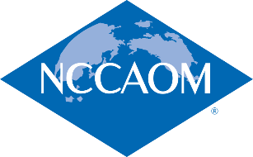
NCCAOM Mission and Core Values
“To assure the safety and well-being of the public and to advance the professional practice of acupuncture and Oriental medicine by establishing and promoting national-based standards of competence and credentialing.”
Testing Excellence
Service
Integrity
Trust
Leadership
Community Support
Notes:
2
Testing Excellence
Our organizational mission drives us to produce valid and reliable measurements of competence in AOM practitioners who seek certification from us.
Service
Public Protection: We are committed to safeguarding the public from practitioners who have not demonstrated their competence.
Public Benefit: We are committed to making available to the public reliable information that will help them to enjoy the benefits of health services from competent AOM practitioners.
AOM Practitioners (Diplomates): We are committed to improving the reputation for excellence of AOM practitioners who have demonstrated competence through our certification processes.
Integrity
We are committed to upholding basic societal norms of truthfulness and honesty in all our organizational words and deeds.
Trust
We are committed to promoting an organizational environment that allows those who work for NCCAOM to rely on one another to accomplish the tasks required by our mission. We maintain the same commitment in our joint activities with other organizations with whom we collaborate for the betterment of the AOM community.
Leadership
We are committed to acting responsibly to advance the interests of the AOM community through our certification process. We understand our leadership to be inseparable from our mission of service to the public and to the AOM community.
Community
Volunteerism: We are committed to engaging AOM practitioners in the activities necessary to keep our certification exams and processes relevant to the state of the art of AOM.
Support: We are committed to being a responsible corporate member of the larger community in which we live.

Slide 3
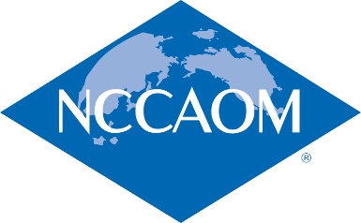
How does NCCAOM meet its mission?
Document eligibility to sit for examinations and to become certified
Develop and administer exams that measure entry level competency
Provide public protection through:
Recertification - competency maintenance and professional development
NCCAOM® Code of Ethics – Adherence monitored through the Professional Ethics and Disicpinary Committee(PEDC)
Working closely with regulatory boards

Slide 4
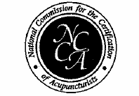
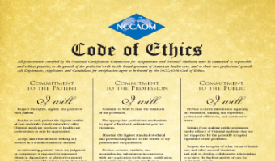

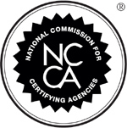
Organizational Overview
History
1982 Founded as the National Commission for the Certification of Acupuncturists (NCCA)
1984 First JTA, Code of Ethics, CNT Course* & CDR for Acupuncture (Ac) certification
1985 First CWE for Acupuncture Certification
1989 Practical Examination of Point Location Skills (PEPLS) introduced
1991 Accredited by the National Organization for Competency Assurance (NOCA)’s National Commission on Certifying Agencies (NCCA)
*Note: CNT Course offered solely by the CCAOM in the 1990’s
Notes:
In 1983 - 84, recognizing that it was essential to set standards of competence, the acupuncture profession in the United States established the National Certification Commission for Acupuncture and Oriental Medicine (NCCAOM). One of the primary reasons for setting national standards was - and is - to protect the public from unqualified practitioners.
Potential harm to the public falls into two primary categories, the risk of accidental injury to internal organs and complications due to improper sterilization and clean needle technique, including the possible spread of infectious disease.

Slide 5
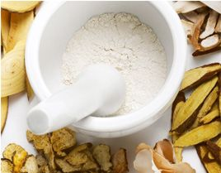
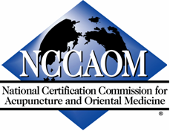


Organizational Overview
History
1995 CWE in Chinese Herbology
1996 Becomes the National Certification Commission for Acupuncture and Oriental Medicine (NCCAOM)
1996 Asian Bodywork Therapy (ABT) certification introduced
1996 Chinese Herbology Certification program is accredited by the NOCA/NCCA
1999 Point Location Examination (PLE) was created as a separate paper and pencil examination

Slide 6


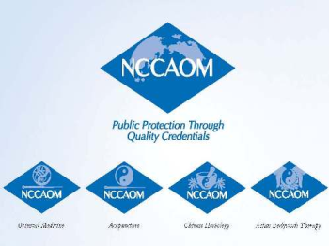
Organizational Overview
History
2003
  Oriental Medicine (OM) Certification introduced
  2003 Job Task Analysis results released
2004
  NCCAOM introduces modular exams
  Biomedicine exam added to certification requirements
  2006
  Computer based testing introduced

Slide 7
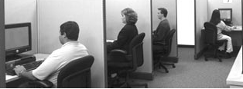

Organizational Overview
History
2007
  Computer Adaptive Testing with Year Round Testing
  Acupuncture, Chinese Herbology and Oriental Medicine programs recognized by the Veterans Administration
  Acupuncture, Asian Bodywork Therapy, and Chinese Herbology programs re-accredited.
  Oriental Medicine program accredited by NCCA
2008
  JTA Analysis conducted

Slide 8
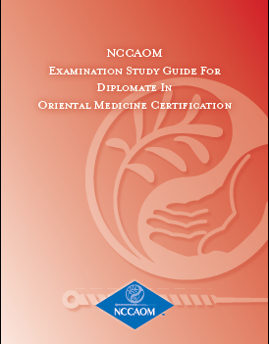
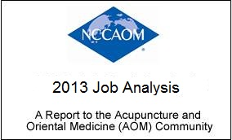
Organizational Overview
History
2009
  NCCAOM publishes first study guides with knowledge, skills and abilities statements for all exam content outlines
  Biomedicine exam content expanded to include safety, ethics, practice management, pharmaceuticals, and supplements
2010
  New 100- MCQ Biomedicine exam
  2008 JTA report released
2012
  Received NCCA reaccreditation in Acupuncture, Chinese Herbology , and Oriental Medicine Certification Programs
2013
  Job Analysis conducted;
  New content outlines and JA Report

Slide 9


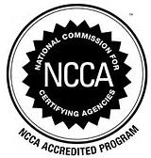
Organizational Overview
History
2014
  NCCAOM sent request to BLS Standard Occupation Classification Policy Committee for Acupuncturists to obtain an independent occupation code.
2016
  NCCAOM Academy of Diplomates was created.
  “Acupuncturists” now have an independent Standard of Occupational Code (SOC). New code for Acupuncturists, SOC – 29-1291, will be included in the next edition of the BLS Occupational Handbook, which will be published in 2018
  CA Acupuncture Board announced that CA will adopt the NCCAOM exams as early as 2019
2017
  Received NCCA reaccreditation in Acupuncture, Chinese Herbology , and Oriental Medicine Certification Programs
  Job Analysis conducted

Slide 10
NCCAOM Profile
NCCAOM Diplomate Profile
19,140 Diplomates Worldwide
As of December 2014

Slide 11
AOM Practice in U.S.
Accreditation and Certification
Accreditation Commission for Acupuncture and Oriental Medicine (ACAOM) www.acaom.org
  Recognized by the U.S. Department of Education
  Forty-eight accredited schools offering Oriental Medicine programs
  Seven accredited schools offering Acupuncture only programs
National Certification Commission for Acupuncture and Oriental Medicine (NCCAOM®) www.nccaom.org
  NCCAOM Acupuncture, Chinese Herbology and Oriental Medicine Certification Programs Accredited by the National Commission for Certifying Agencies (NCCA)
As of 3/6/2015
Notes:
Currently there are over 60 accredited Acupuncture or Oriental Medicine programs in the U.S.
The majority of licensed acupuncturists also practice acupuncture and herbal medicine (70%)
Other modalities provided by licensed acupuncturists:
Bodywork Therapy
Dietary Therapy
Physical & Mind/Body Exercises
External practices, including moxibustion and cupping
Currently there are over 60 accredited Acupuncture or Oriental Medicine programs in the U.S.
The majority of licensed acupuncturists also practice acupuncture and herbal medicine (70%)
Other modalities provided by licensed acupuncturists:
Bodywork Therapy
Dietary Therapy
Physical & Mind/Body Exercises
External practices, including moxibustion and cupping
70% of schools that offer OM Master’s programs offer separate Acupuncture and Oriental Medicine programs while 30% offer combined OM programs

Slide 12
AOM Practice in U.S.:
Accreditation Commission for Acupuncture and Oriental Medicine (ACAOM) www.acaom.org
  Recognized by the U.S. Department of Education
  Fifty-six schools in accredited or candidacy status
    Twenty-eight accredited Acupuncture Programs
    Forty-eight accredited Oriental Medicine Programs
    Twelve accredited Doctor of Acupuncture and Oriental Medicine Programs
As of 3/6/2015
Notes:
Currently there are over 60 accredited Acupuncture or Oriental Medicine programs in the U.S.
The majority of licensed acupuncturists also practice acupuncture and herbal medicine (70%)
Other modalities provided by licensed acupuncturists:
Bodywork Therapy
Dietary Therapy
Physical & Mind/Body Exercises
External practices, including moxibustion and cupping
Currently there are over 60 accredited Acupuncture or Oriental Medicine programs in the U.S.
The majority of licensed acupuncturists also practice acupuncture and herbal medicine (70%)
Other modalities provided by licensed acupuncturists:
Bodywork Therapy
Dietary Therapy
Physical & Mind/Body Exercises
External practices, including moxibustion and cupping
70% of schools that offer OM Master’s programs offer separate Acupuncture and Oriental Medicine programs while 30% offer combined OM programs

Slide 13
AOM Practice in U.S.
Requirements for Diplomate of Acupuncture or
Oriental Medicine
Complete a 3 or 4 year Master’s degree program approved by the Accreditation Commission for Acupuncture & Oriental Medicine (ACAOM).
Earn up to 3,000 combined didactic and clinical contact hours.
Acquire a Clean Needle Technique (CNT) Certificate from the Council of Colleges of Oriental Medicine (CCAOM).
Pass NCCAOM certification exams:
    Foundations of OM
    Acupuncture with Point Location
    Chinese Herbology (OM program only)
    Biomedicine

Slide 14
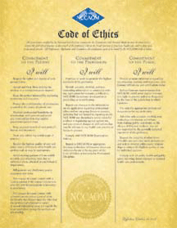
AOM Practice in U.S.
Requirements for Diplomate of Acupuncture or
Oriental Medicine
All Diplomates must abide by the:
NCCAOM® Code of Ethics
Grounds for Professional Discipline
Procedures for Upholding Professional Conduct
  The NCCAOM Professional Ethics and Disciplinary Committee (PEDC) has the authority to investigate disciplinary actions taken against NCCAOM applicants and Diplomates and to impose sanctions on NCCAOM applicants and Diplomates according to the NCCAOM Procedures for Upholding Professional Conduct.

Slide 15
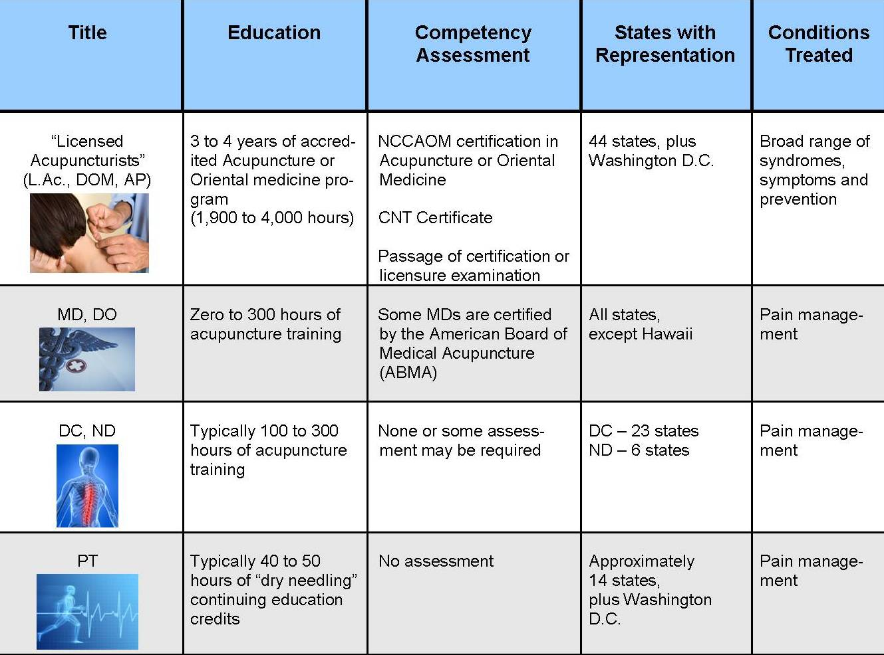
Qualifications of Licensed Acupuncturists Compared to Other Healthcare Providers
*Modified with permission from the Council of Colleges of Acupuncture and Oriental Medicine
Notes:
Currently there are over 60 accredited Acupuncture or Oriental Medicine programs in the U.S.
The majority of licensed acupuncturists also practice acupuncture and herbal medicine (70%)
Other modalities provided by licensed acupuncturists:
Bodywork Therapy
Dietary Therapy
Physical & Mind/Body Exercises
External practices, including moxibustion and cupping

Slide 16

NCCAOM’s Role in Supporting Licensure in the U.S.
Current Impact
  NCCAOM’s examinations are required in 44 states plus Washington, D.C.
  98% of states that regulate acupuncture require NCCAOM examinations
  25 states require full NCCAOM certification in Acupuncture, Chinese Herbology and/or Oriental Medicine
NCCAOM National Standards Fact Sheets
  NCCAOM Certification and Testing Program
  NCCAOM Meeting National Standards Through its Examinations and Certification Process

Slide 17
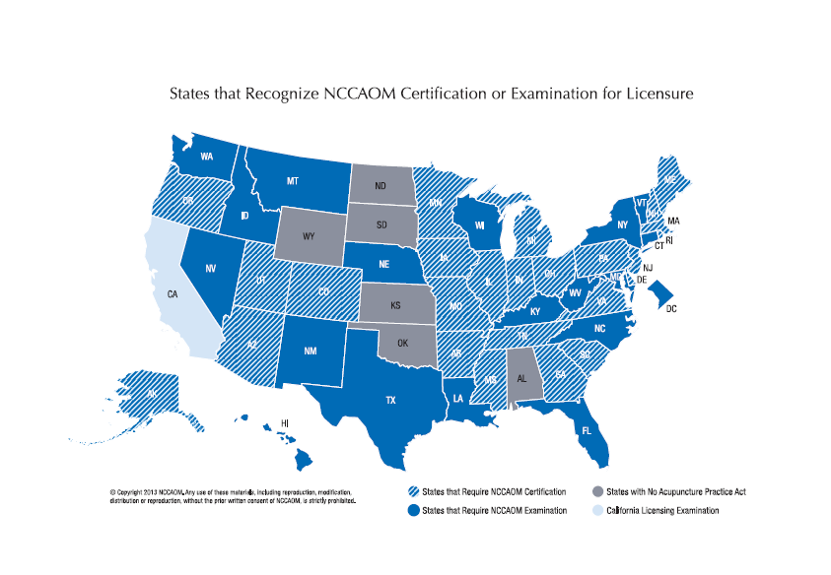
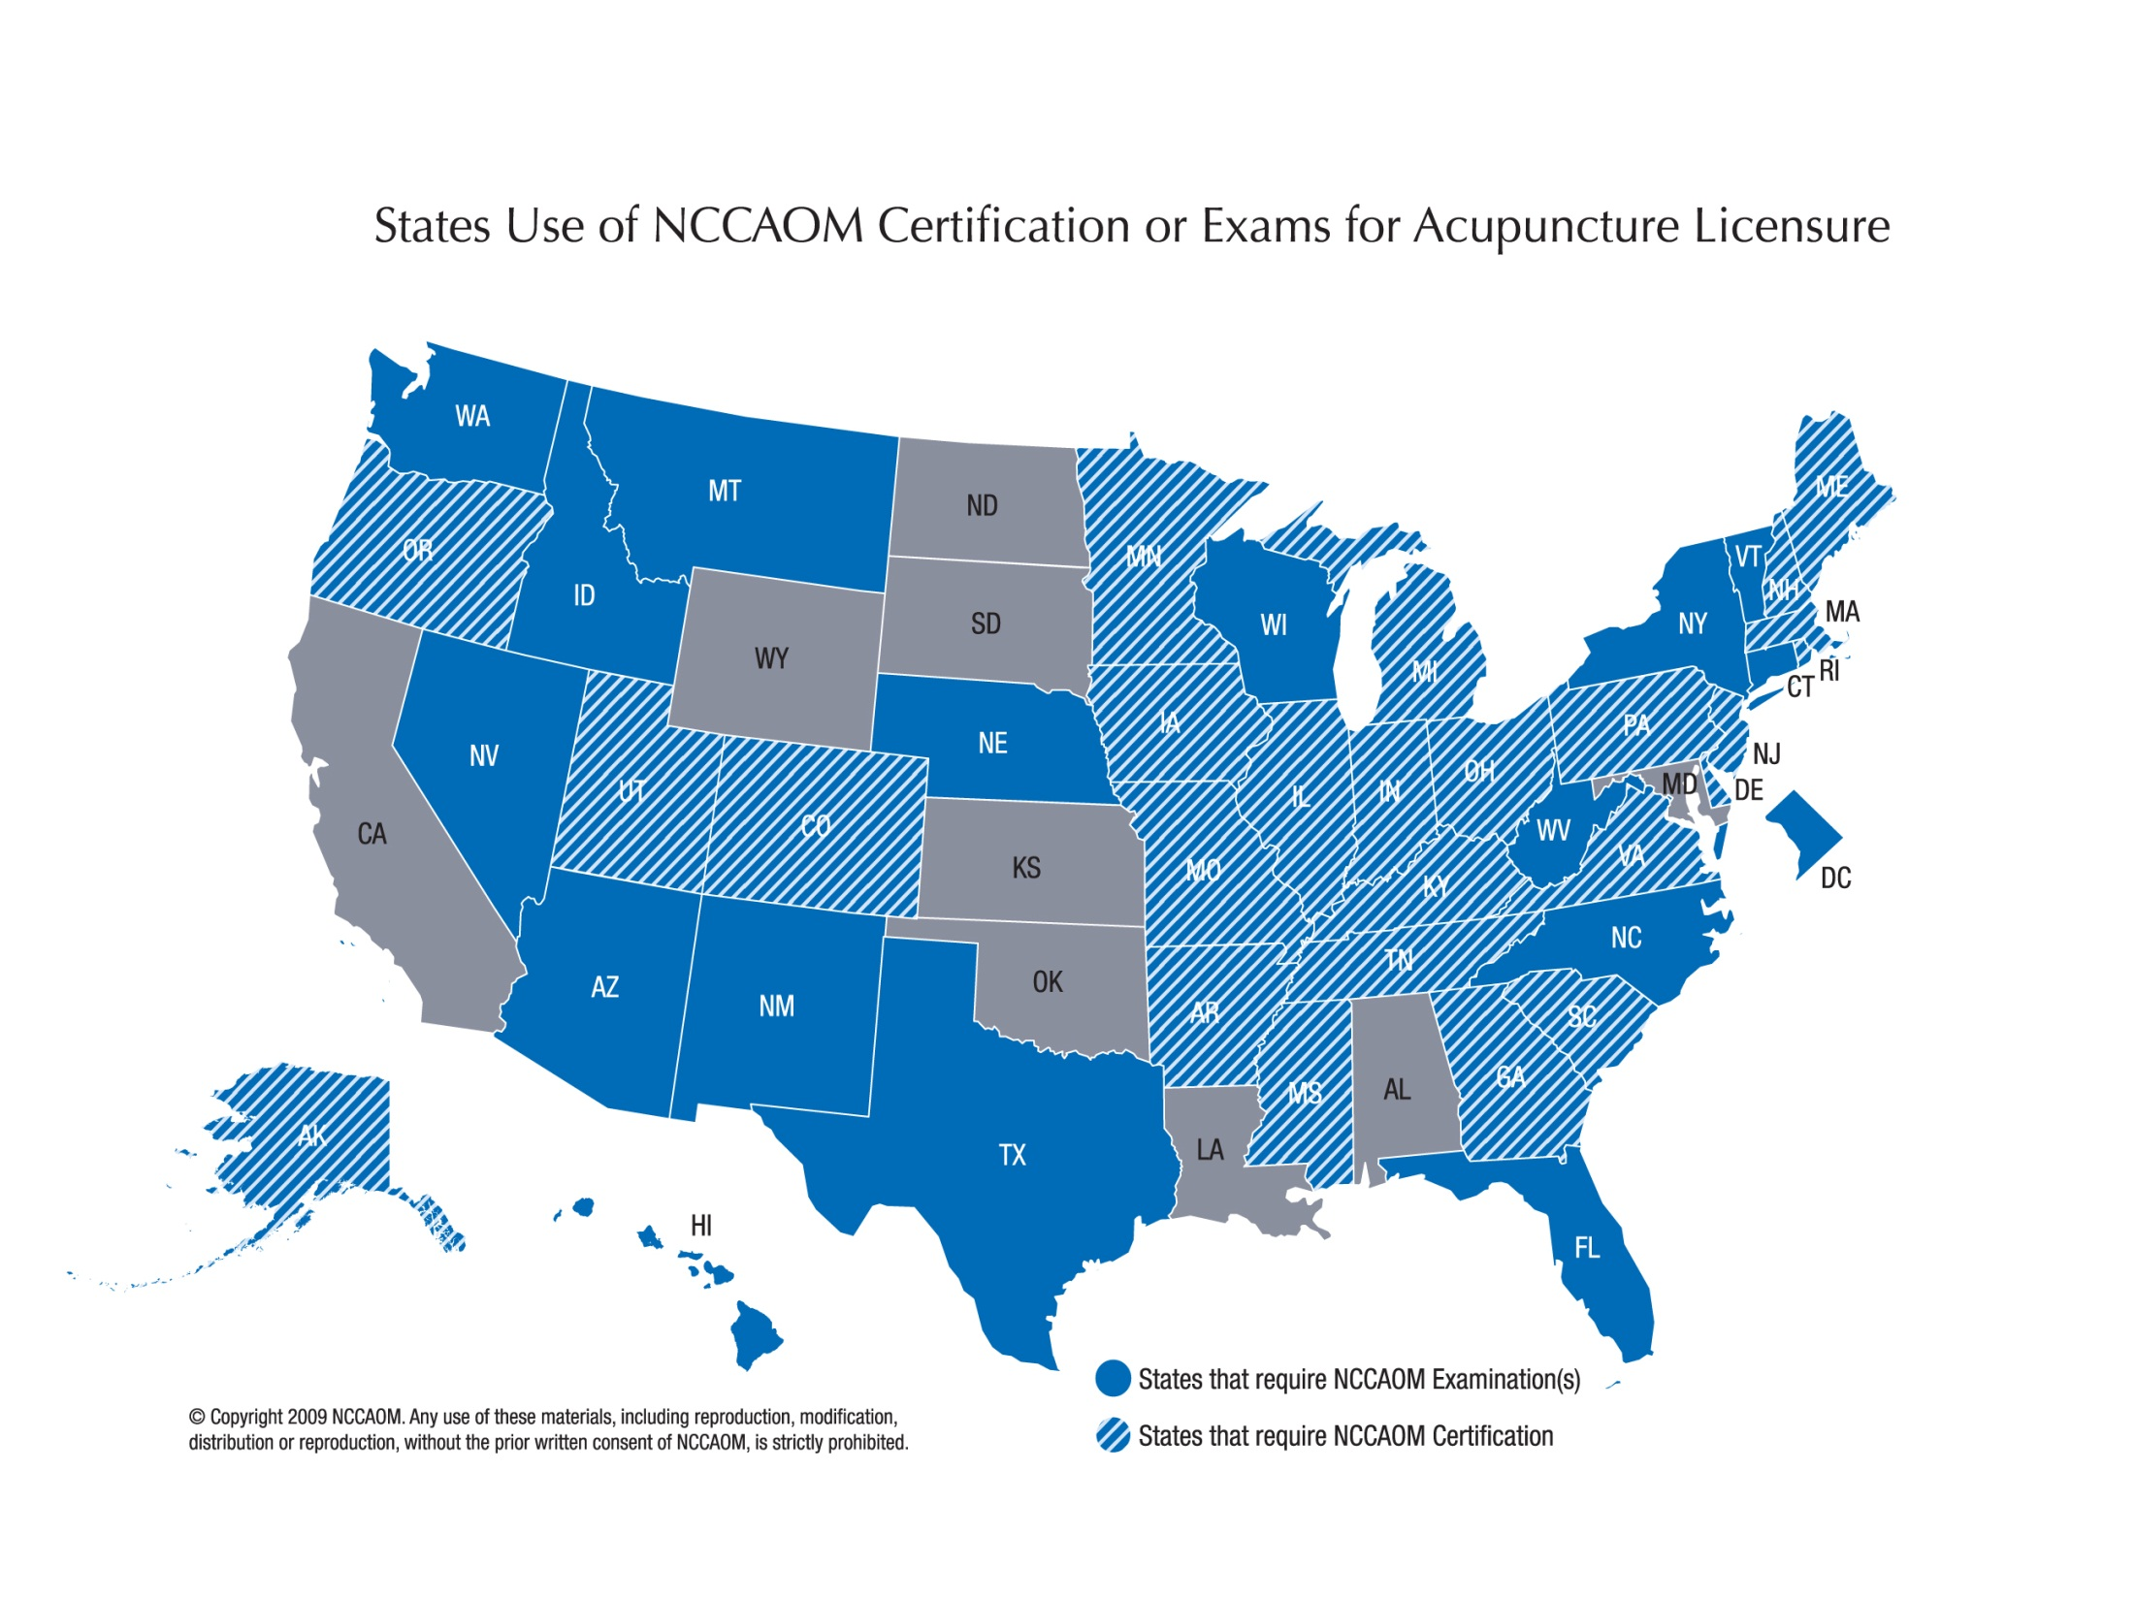
Notes:
25 states require NCCAOM certification.

Slide 18
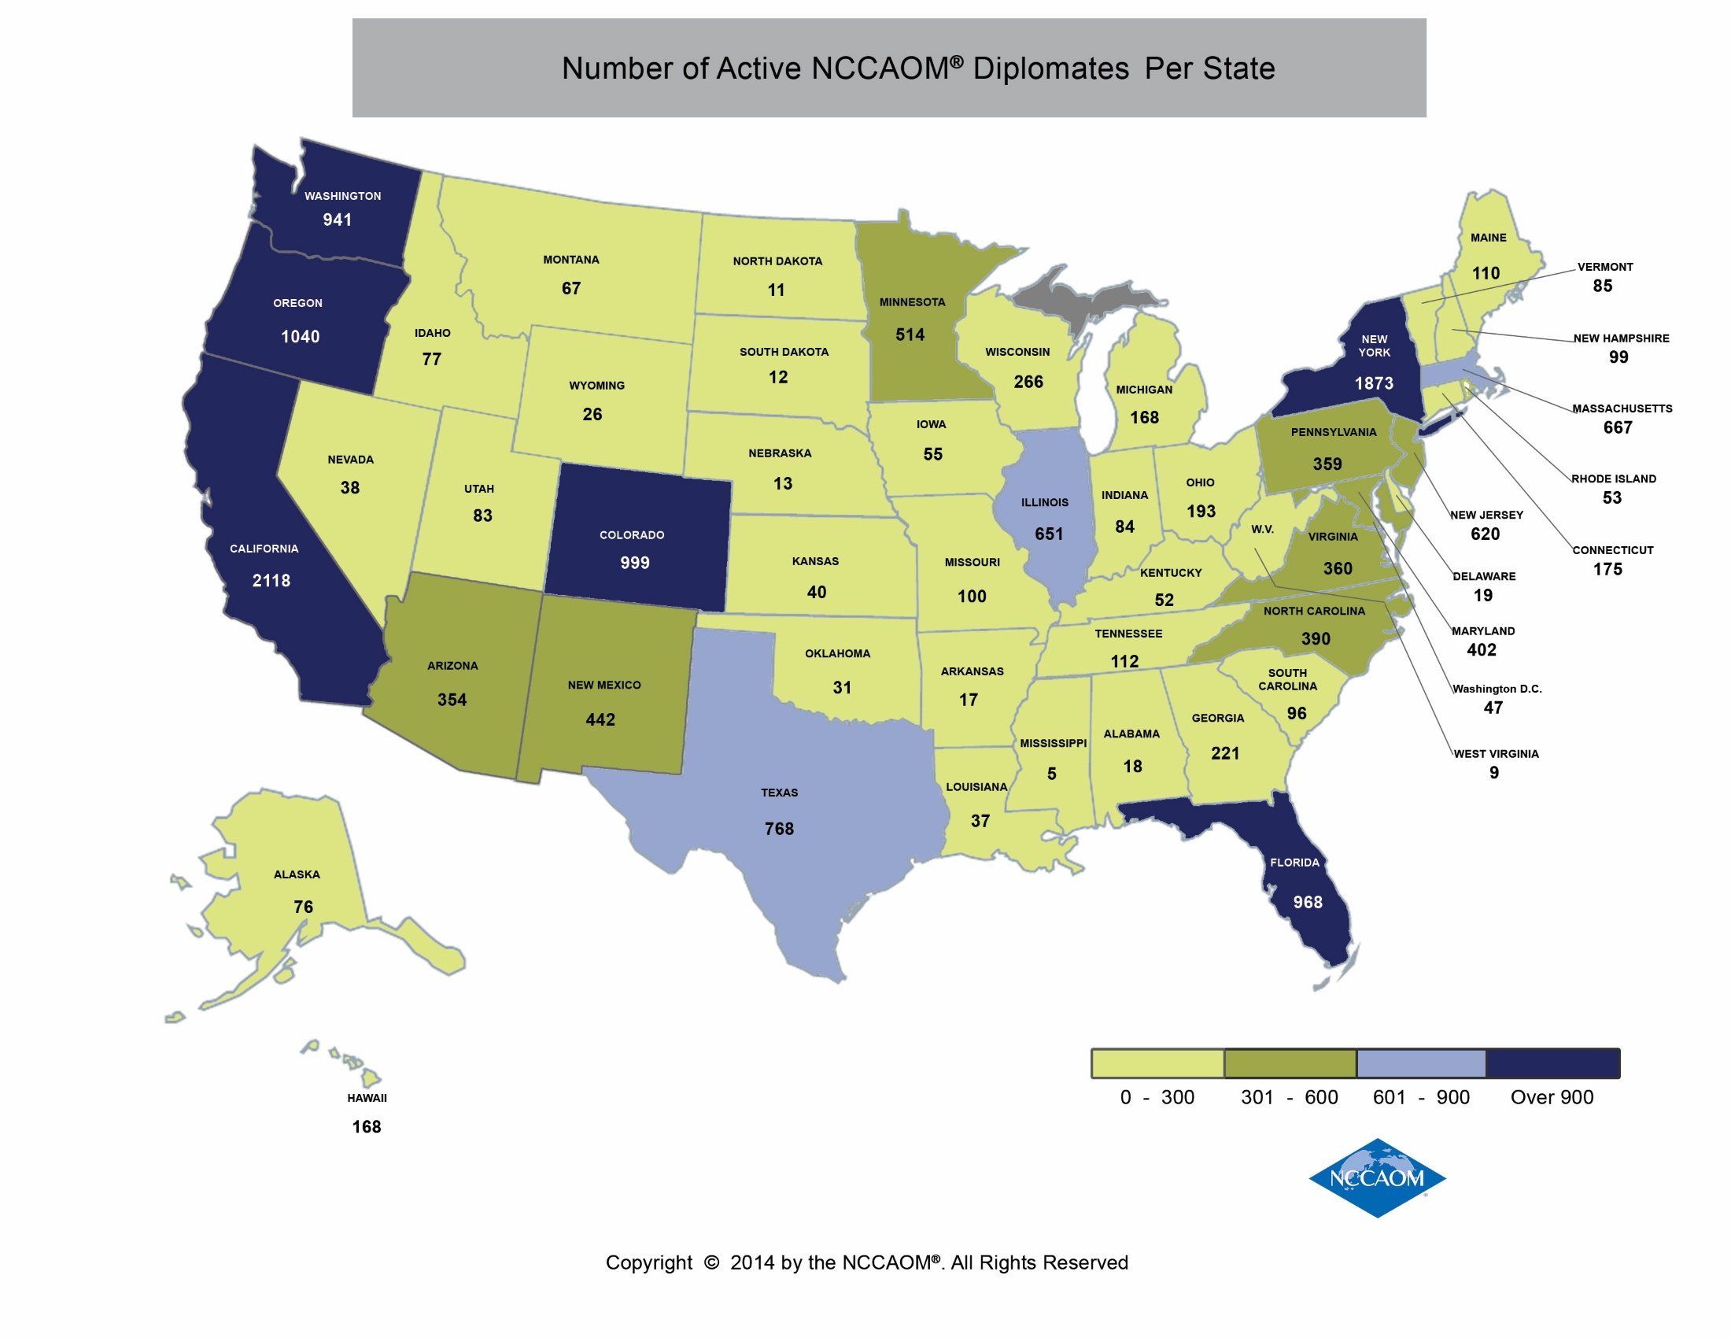
As of August 2013

Slide 19
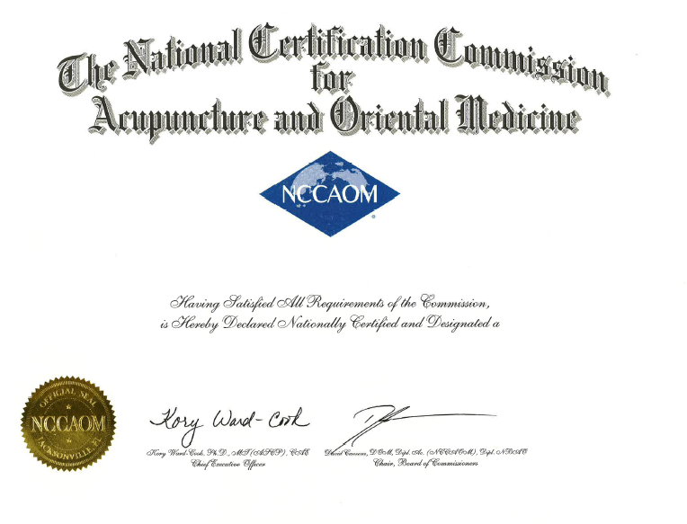
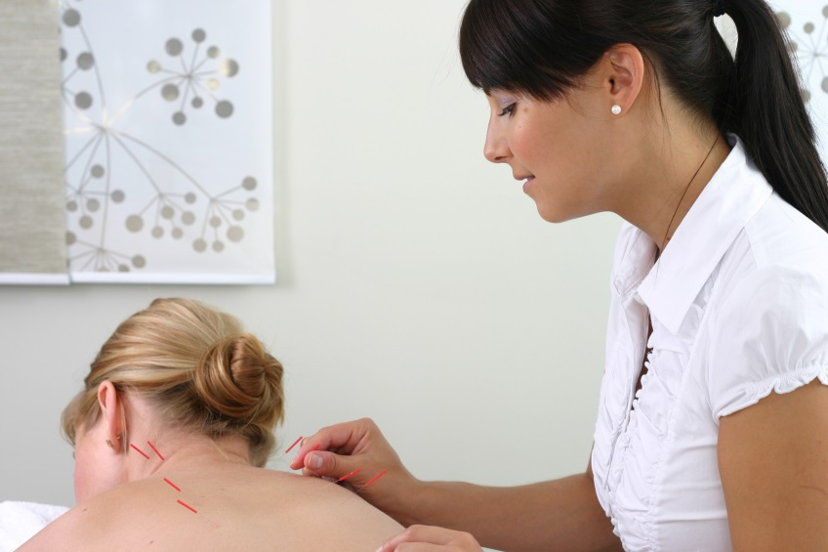
NCCAOM Certification Requirements
Notes:
Sheila Starts Presentation Here:
If we go too fast through these slides, please note that Certification Services staff are on hand and happy to answer questions at the end of the presentation or by email at info@thenccaom.org.

Slide 20
Credentials of an NCCAOM Certified Acupuncturist or OM Practitioner in the U.S.
Complete a 3 or 4 year master’s degree program approved by the Accreditation Commission for Acupuncture & Oriental Medicine (ACAOM).
Up to 3,000 combined didactic and clinical contact hours.
Acquire a Clean Needle Technique Certificate.
Pass required NCCAOM certification exams.

Slide 21
Eligibility to Test
Certification Requirements
Eligibility To Test
Certification Requirements
Attend a school accredited by ACAOM
Graduation from an academic program that meets eligibility requirements
Graduation transcript on file with the NCCAOM
Passing score on all required certification exams
CNT Verification on file with the NCCAOM
Graduation or Pre-Grad Transcript on file with NCCAOM
Graduation Transcript on file with NCCAOM
Foreign Credential Review
Graduation from an academic program that meets eligibility requirements
All Applicants
U.S. Applicants Only
International Applicants
Notes:
The next slice refers to the difference between eligibility to test and certification requirements.
U.S. student, your school must submit either a pre-graduation or graduation transcript directly to the NCCAOM.
During pre-graduation, your school determines which exams are approved for you to take.
Once a student graduates…and applies for NCCAOM certification.. exam modules are approved by the NCCAOM after receipt of the graduation transcript.
International
First complete a foreign education review
Read Route 2: Formal Education for International Applicants for information on all eligibility requirements.
Certification Requirements – read slide
Complete CNT before taking BIOM
CNT from CCAOM full-day in-person
Valid 6 years
English language proficiency – 2015
Stakeholder input

Slide 22
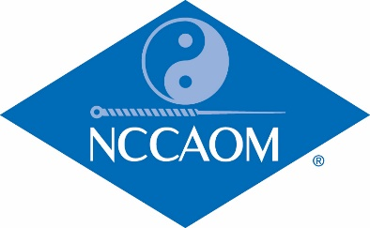
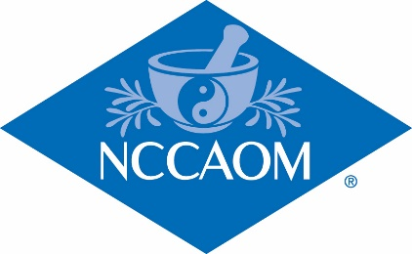
NCCAOM Certification Programs
and Exam Requirements
Acupuncture Certification:
Foundations of Oriental Medicine Exam
Acupuncture with Point Location Exam
Biomedicine Exam
Chinese Herbology Certification:
Foundations of Oriental Medicine Exam
Chinese Herbology Exam
Biomedicine Exam
Applications for certification expire 4 years after received by NCCAOM
Notes:
22
Taking the exams may or may not be required
by your state to prescribe herbs.

Slide 23
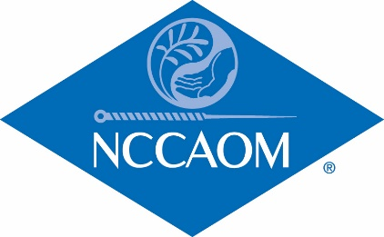
NCCAOM Certification Programs
and Exam Requirements
Oriental Medicine Certification:
Foundations of Oriental Medicine Exam
Acupuncture with Point Location Exam
Chinese Herbology Exam
Biomedicine Exam
This certification meets or exceeds the exam requirements for 46 states plus District of Columbia.

Slide 24

Certification Exams By Program
Certification Examinations (100 items each) | AC | CH | OM
Foundations of Oriental Medicine
Biomedicine
Acupuncture with Point Location
Chinese Herbology
Notes:
Candidates must pass each of the following exams to be awarded NCCAOM Certification:
Not a % - scaled score, weighted – Study Guides – Applicants, approved candidate, Examination Info – General, Exam Scoring
Notarized application – certification awarded
Reapply change certification

Slide 25
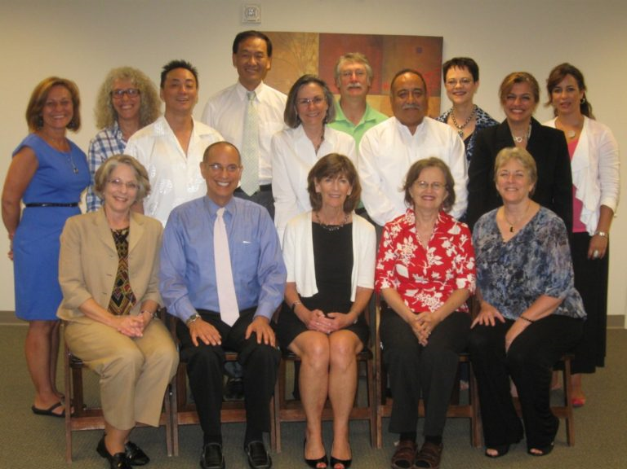
NCCAOM Examination Development
Subject Matter Experts (SMEs) who serve on examination development committees represent diversity within the profession.
SMEs come from various geographic locations and practice settings.
Throughout the year, Item Writing Workshops are conducted to provide draft questions for SME committee members to consider.
Experienced Item Writers are asked to become a part of the prestigious NCCAOM Item Writing Academy.

Slide 26

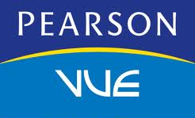
NCCAOM Testing Vendors
The NCCAOM examinations are administered by Pearson VUE who has test centers in 175 countries across the world (including Taiwan, China and Korea)
Pearson VUE offers state-of-the-art security for its exam sites
SMT provides all psychometric analyses for each administration, including scoring.

Slide 27
NCCAOM Job Analysis
Since the NCCAOM examinations test competence to practice, an extensive job analysis survey is sent to practitioners every 5 years.
The job survey identifies frequency and criticality of job tasks.
Results of the survey are applied to the content outline.
If a modality is not practiced with enough frequency, or is not deemed critical to the job it is not tested on the examination.

Slide 28
NCCAOM® Contacts
Dr. Kory Ward-Cook, CEO
  kwardcook@thenccaom.org
Mina Larson, Deputy Director
  mlarson@thenccaom.org

